Slide 1

Team 2
Language Immersion in AR/VR

Slide 2
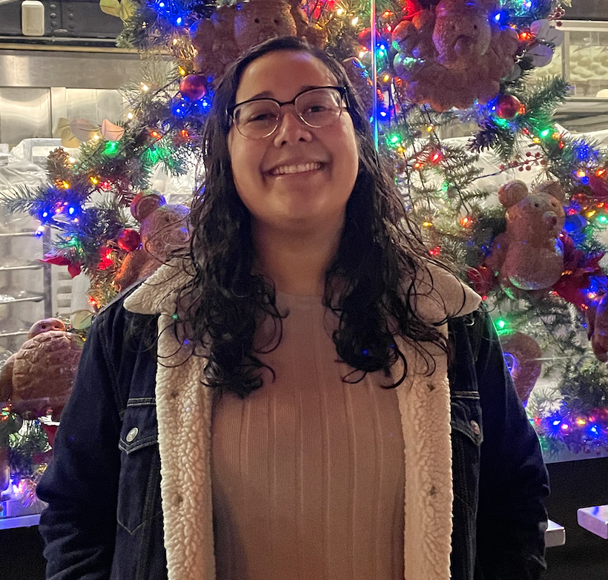

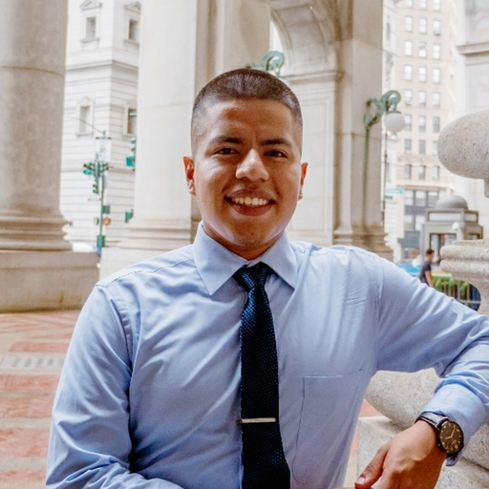
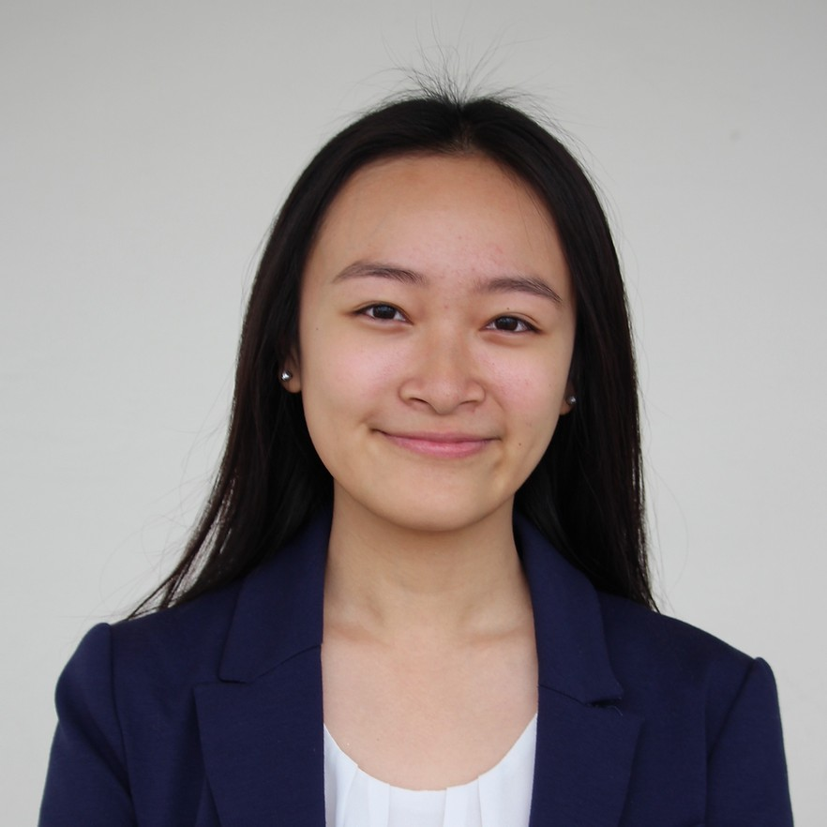
Team Members
SELAINE RODRIGUEZ
ANNA CHANG
WILMER ZUNA LARGO
AMANDA HUYNH

Slide 3
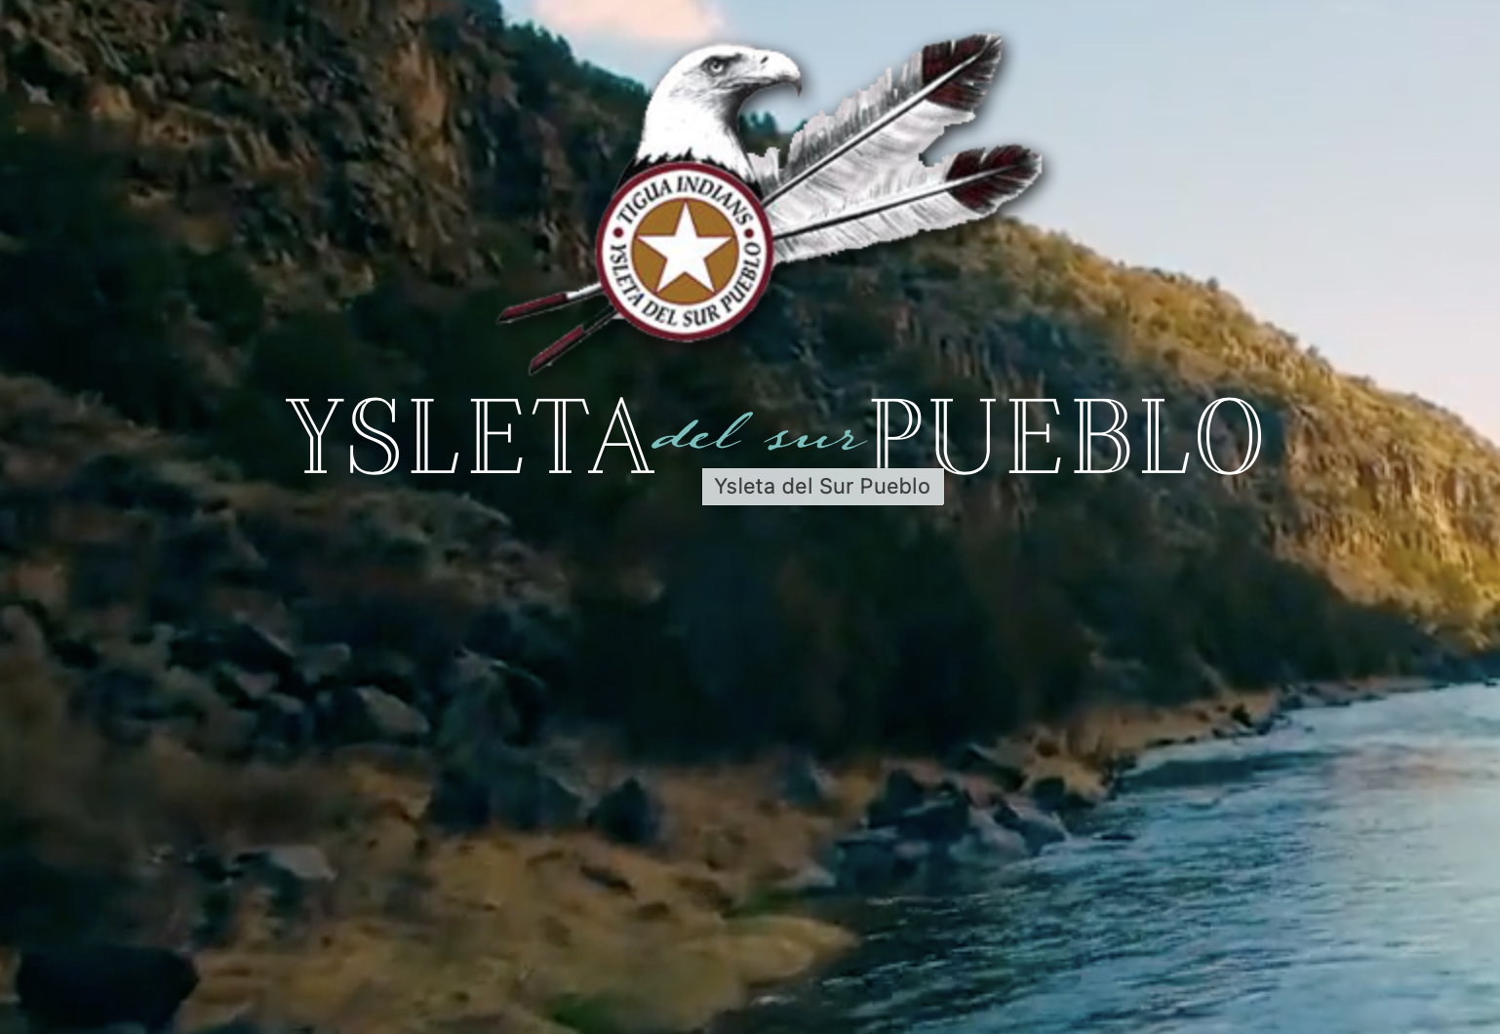

Slide 4
Immersive Language Learning
Problem Domain
Education and AR/VR Technology

Slide 5
Initial POV

Slide 6
Additional Needfinding Results

Slide 7

Initial POV
The initial POV we created in Studio was based on one of our first needfinding interviewees:
We met Claudia, a Hispanic Stanford Chef, Culinary student, and mother of 3, who learned English after immigrating to the U.S.
We were surprised to notice as an active English learner, Claudia implements a strict No-English speaking rule at home, despite the desire to want to practice it [English] so that she does not become over-dependent on her children.
We wonder if this means that Claudia prioritizes her children by making sacrifices in regards to skill learning and time so that they maintain their language and culture.
It would be game-changing to provide encouragement and support in balancing her language roots and goals.

Slide 8




Needfinding Interviewees
Adria
John
Chris
May
Age: Early-50s
Occupation: Spanish Teacher
Languages: English, Spanish, French
Age: Early-60s
Occupation:
Math Teacher
Languages: English, Spanish, German
Age: Early-20s
Occupation:
College Student at NMSU
Languages: English, Spanish, South Tiguan
Age: Early-40s
Occupation:
Japanese Professor
Languages: English, Japanese, Korean, Chinese
Notes:
Adria
As a Spanish teacher, sees that people don’t practice the language entirely
Learned french when in HS but only really practiced when living in France, now doesn’t know any of it
“Use it or lose it”
Advocate for immersion programs and experiences
John
Although he lives in El Paso (predominantly latinx and almost everyone speaks Spanish), he hasn’t been able to learn the language
Duolingo user and tries to practice a little bit everyday but only knows small phrases
Doesn’t speak Spanish with his students but will let them speak it in the classroom

Slide 9

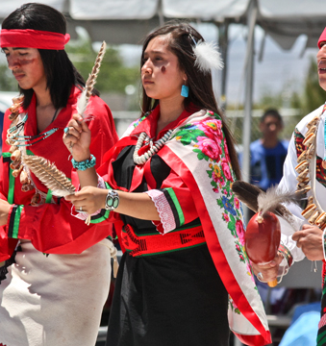

Needfinding Interview Results
Things we found different:
Immersion
  Current tools do not offer this
Culture
  Cultural dishes and traditions
  Particularly for our indigenous interviewee
Easier/more approachable to learn similar languages
  However, not as interested because it was “too easy”

Slide 10
POVs

Slide 11

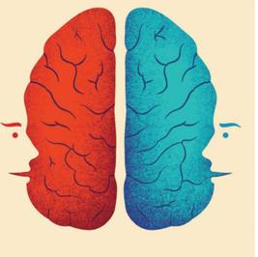


Adria
POV:
We met Adria Hernandez, a high school Spanish teacher who has taught at a predominantly Latinx/bilingual school for 24 years.
We were surprised to notice that she was openly communicating that the school’s administration’s approach to language learning did not align with what her professional opinion was.
We wonder if this means that she prioritizes the “survival instinct” or immersion form of language learning rather than the standards-based form of achievement-measuring.
It would be game changing for Ms. Hernandez to have access to learning environments/tools that can provide a form of immersion while still being in the classroom.
Age: Early-50s
Occupation: Spanish Teacher
Languages: English, Spanish, French
Notes:
How might we recreate immersive learning experiences?
How might we foster survival instincts in language learning?
How might we maintain students motivated in language learning?
How might we incentivize students to learn languages?
How might we make language learning easy?
How might we help develop further and deeper understanding of the material that people are reading/watching as they learn?
How might we encourage students to become fully immersed in a language if they do not have the means to study abroad or access to language conversation partners outside of school?
How might we encourage teachers with decades of experience to help newer teachers develop strong teaching skills to best help new language learners?
How might we help give teachers the right to change their syllabus and exchange language teaching strategies to best help students?
How might we ensure that pedagogy and learning practices are the most recent and effective for students?
How might we bring the uniqueness and eagerness - main reasons to visit foreign places - in language learning?

Slide 12

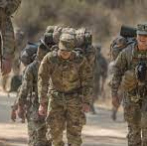

John
POV:
We met John Gullickson, a retired veteran stationed in Germany during his time in the army and current high school Math teacher who has taught at a predominantly Latinx/bilingual school for 24 years.
We were surprised to notice that despite not completely-understanding Spanish and struggling with learning it himself, he allows students to speak Spanish freely in the classroom.
We wonder if this means his teaching style is influenced by his initial experiences with learning German while in Germany.
It would be game changing to create a similar friendly experience for Mr. Gullickson while he continues to learn Spanish.
Age: Early-60s
Occupation:
Math Teacher
Languages: English, Spanish, German
Notes:
How might we provide cultural information for language learning?
How might we create a comfortable and non-judgemental environment for language practice?
How might we provide opportunities for language learners to practice speaking and listening skills?
How might we motivate people to study languages they may not “need to”?
How might we help those who already know parts of the language get past that initial learning curve?
How might we help mimic the “immersion” experience?
How might we create ways for language learners to better identify differences between regional dialects of a language?
How might we capture the different dialects and nuances of language that are not often taught in textbooks and other materials?
How might we honor the past learning experiences of individuals who have extraneous life experiences and education?
How might we foster communal-oriented learning to work towards a shared goal?
How might we keep students motivated to learn?
How might we help language learners set dedicated time aside for practice?
How might we making language learning less intimidating / seem less “intense”?

Slide 13

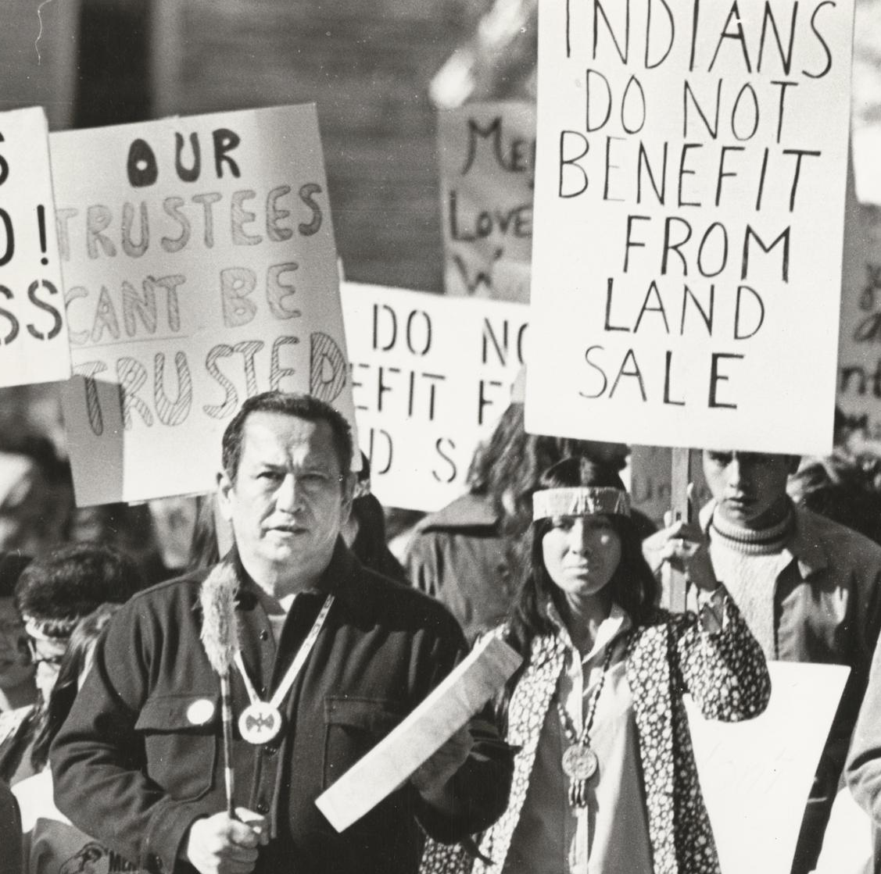
Chris
POV:
We met Christopher (Chris) Gomez, a college student at New Mexico State University (NMSU) and a member of the Ysleta Del Sur Pueblo tribe in El Paso, TX.
We were surprised to notice that the revitalization of the South Tiguan language was not a main priority of the tribe.
We wonder if this means that larger issues such as getting their land back from El Paso County and the Ysleta Del Sur Pueblo v. Texas court case are detracting from the cultural and social aspects of the group.
It would be game changing to mediate the larger needs of the community and the maintenance of their language and cultural roots.
Age: Early-20s
Occupation: College Student at NMSU
Languages: English, Spanish, South Tiguan
Notes:
How might we develop language learning guides for local schools to encourage them to teach the history of Native American tribes and the basics of their native languages, with the utmost respect?
How might we help indigenous tribes teach one another their languages without feelings of frustration when the other party doesn’t understand or speaks too fast?
How might we make it easier for traditional tribe councils to connect and exchange languages from other nearby indigenous communities?
How might we appreciate Native languages and Native cultures in a respectful way in schools and minimize racism surrounding Native language pride?
How might we address financial concerns for traditional tribes in learning languages?
How might we ensure that individuals at any age can develop fluency in a language they are excited about?
How might we create opportunities for language learning without readily accessible immersive environments / native speakers?
How might we encourage indigenous tribes to provide more language learning opportunities for their younger generations so it is easier for the tribe to keep the language alive instead of defaulting to another language as their main form of communication?
How can we help indigenous tribes develop a language guide and resource for newer folks who are learning the language so the newer generations don’t start to make up new words as they go?
How might we address the lack of resources that exists for indigenous languages?
How can we honor the oral practices/traditions of the culture while also aiming to provide resources of other forms (written, pictures, etc.)?
How might we tie the languages that are currently understood (English and Spanish) to the revival of their native language (South Tiguan)?
How might we maintain the important cultural factors associated with different languages?

Slide 14



May
POV:
We met May Miao, a Chinese-born university professor who has taught Japanese for five years, motivated to begin studying Japanese herself by historical events between China and Japan.
We were surprised to notice that despite thinking that learning Korean was “too easy” and very similar to Chinese and Japanese, she has not stayed motivated to continue studying it beyond her PhD.
We wonder if this means that learners should study language and culture/history concurrently to stay interested.
It would be game changing to provide May with a way to continue studying Korean in tandem with better understanding Korea’s culture and history.
Age: Early-40s
Occupation:
Japanese Professor
Languages: English, Chinese, Japanese, Korean
Notes:
How might we take advantage of the languages that someone already knows to help them learn more?
How can we integrate historical knowledge into language lessons and learning?
How can we be sensitive about cultural differences or historical conflicts when teaching individuals a new language?
How can we help create an engaging environment that keeps people interested?
How might we take advantage of initial interests in a language to further those ideas?
How can we popularize new types of practice methods for language learning (ex. Journaling everyday in the language you’re learning)?
How might we make classroom learning less like a task?
How can we encourage people to learn languages, even as adults?
How can we help language learners feel more confident in their existing skills?
How can we help people make the time to study a language?
How can we make language learning approachable but not too easy/simplified?

Slide 15
HMW Statements

Slide 16
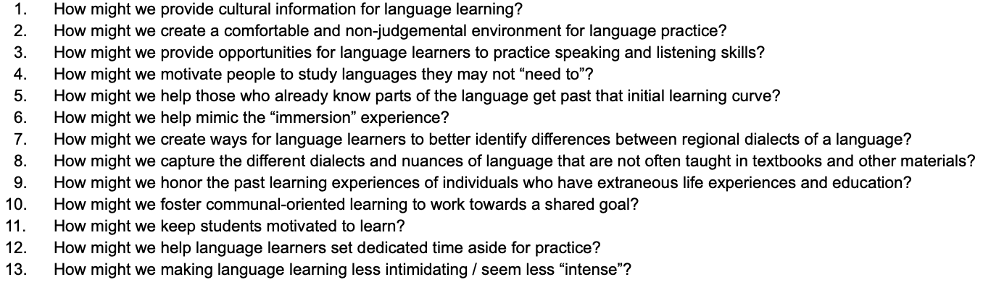
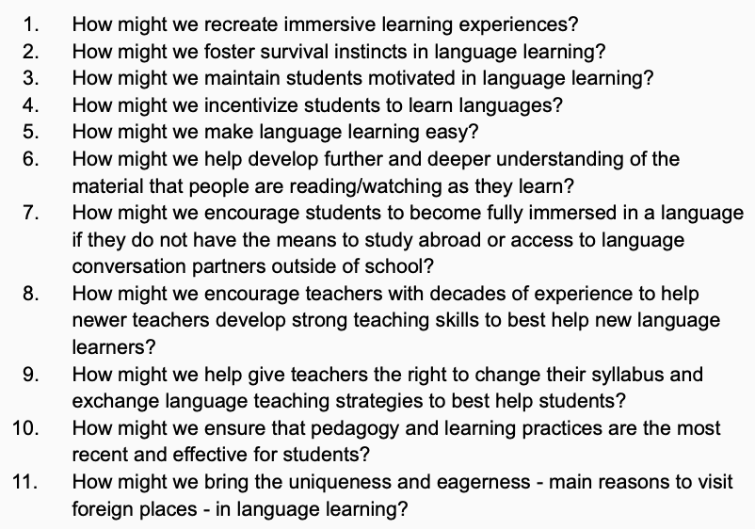
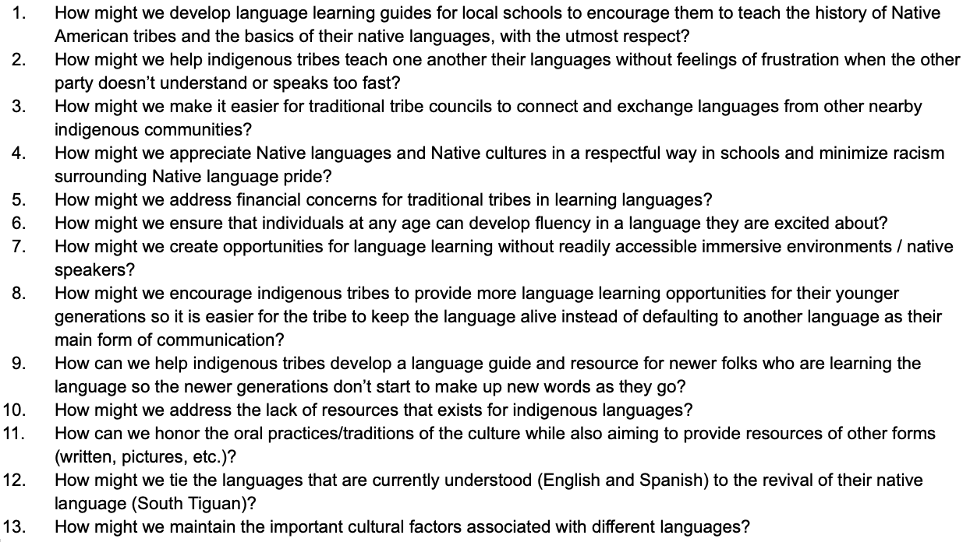
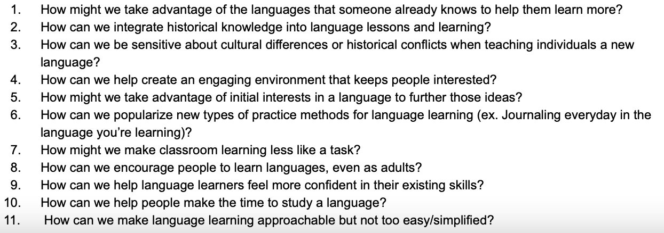
All HMWs
Notes:
POV 1 HMWs (Spanish Teacher)
How might we recreate immersive learning experiences?
How might we foster survival instincts in language learning?
How might we maintain students motivated in language learning?
How might we incentivize students to learn languages?
How might we make language learning easy?
How might we help develop further and deeper understanding of the material that people are reading/watching as they learn?
How might we encourage students to become fully immersed in a language if they do not have the means to study abroad or access to language conversation partners outside of school?
How might we encourage teachers with decades of experience to help newer teachers develop strong teaching skills to best help new language learners?
How might we help give teachers the right to change their syllabus and exchange language teaching strategies to best help students?
How might we ensure that pedagogy and learning practices are the most recent and effective for students?
How might we bring the uniqueness and eagerness - main reasons to visit foreign places - in language learning?
POV 2 HMWs (Math Teacher)
How might we provide cultural information for language learning?
How might we create a comfortable and non-judgemental environment for language practice?
How might we provide opportunities for language learners to practice speaking and listening skills?
How might we motivate people to study languages they may not “need to”?
How might we help those who already know parts of the language get past that initial learning curve?
How might we help mimic the “immersion” experience?
How might we create ways for language learners to better identify differences between regional dialects of a language?
How might we capture the different dialects and nuances of language that are not often taught in textbooks and other materials?
How might we honor the past learning experiences of individuals who have extraneous life experiences and education?
How might we foster communal-oriented learning to work towards a shared goal?
How might we keep students motivated to learn?
How might we help language learners set dedicated time aside for practice?
How might we making language learning less intimidating / seem less “intense”?
POV 3 HMWs (Indigenous College Student)
How might we develop language learning guides for local schools to encourage them to teach the history of Native American tribes and the basics of their native languages, with the utmost respect?
How might we help indigenous tribes teach one another their languages without feelings of frustration when the other party doesn’t understand or speaks too fast?
How might we make it easier for traditional tribe councils to connect and exchange languages from other nearby indigenous communities?
How might we appreciate Native languages and Native cultures in a respectful way in schools and minimize racism surrounding Native language pride?
How might we address financial concerns for traditional tribes in learning languages?
How might we ensure that individuals at any age can develop fluency in a language they are excited about?
How might we create opportunities for language learning without readily accessible immersive environments / native speakers?
How might we encourage indigenous tribes to provide more language learning opportunities for their younger generations so it is easier for the tribe to keep the language alive instead of defaulting to another language as their main form of communication?
How can we help indigenous tribes develop a language guide and resource for newer folks who are learning the language so the newer generations don’t start to make up new words as they go?
How might we address the lack of resources that exists for indigenous languages?
How can we honor the oral practices/traditions of the culture while also aiming to provide resources of other forms (written, pictures, etc.)?
How might we tie the languages that are currently understood (English and Spanish) to the revival of their native language (South Tiguan)?
How might we maintain the important cultural factors associated with different languages?
POV 4 HMWs (Japanese Professor)
How might we take advantage of the languages that someone already knows to help them learn more?
How can we integrate historical knowledge into language lessons and learning?
How can we be sensitive about cultural differences or historical conflicts when teaching individuals a new language?
How can we help create an engaging environment that keeps people interested?
How might we take advantage of initial interests in a language to further those ideas?
How can we popularize new types of practice methods for language learning (ex. Journaling everyday in the language you’re learning)?
How might we make classroom learning less like a task?
How can we encourage people to learn languages, even as adults?
How can we help language learners feel more confident in their existing skills?
How can we help people make the time to study a language?
How can we make language learning approachable but not too easy/simplified?

Slide 17
01
02
03
How might we foster survival instincts in language learning?
How might we capture the different dialects and nuances of language that are not often taught in textbooks and other materials?
How might we maintain the important cultural factors associated with different languages while respectfully appreciating the history and people behind these languages?
Top Three HMWs

Slide 18
Solutions
Notes:
three

Slide 19
01
02
03
VR choose your own adventure storylines that places you in different scenarios you might encounter when you are abroad in a new country.
AR/VR cooking application where you prepare recipes and dishes from other countries while fully immersed in another language.
VR/AR singing app where learners can sing along prepared-AR music videos in different dialects of a language with subtitled lyrics/phonetic pronunciations.
Top Three Solutions

Slide 20
Experience Prototypes

Slide 21




Experience Prototype Testers
Marlon
Sam
Lauren
Brenda
Age: Early-20s
Occupation:
College Student at U.C. Merced
Languages: English, Spanish, Cantonese
Age: Early-20s
Occupation:
College Student at Texas A&M
Languages: English, Spanish
Age: Early-20s
Occupation:
College Student at Stanford
Languages: English, Spanish, Korean
Age: Early-20s
Occupation:
College Student at U.T. Austin
Languages: English, Spanish, French
Notes:
Agricultural and Mechanical College of Texas
The University of Texas at Austin

Slide 22
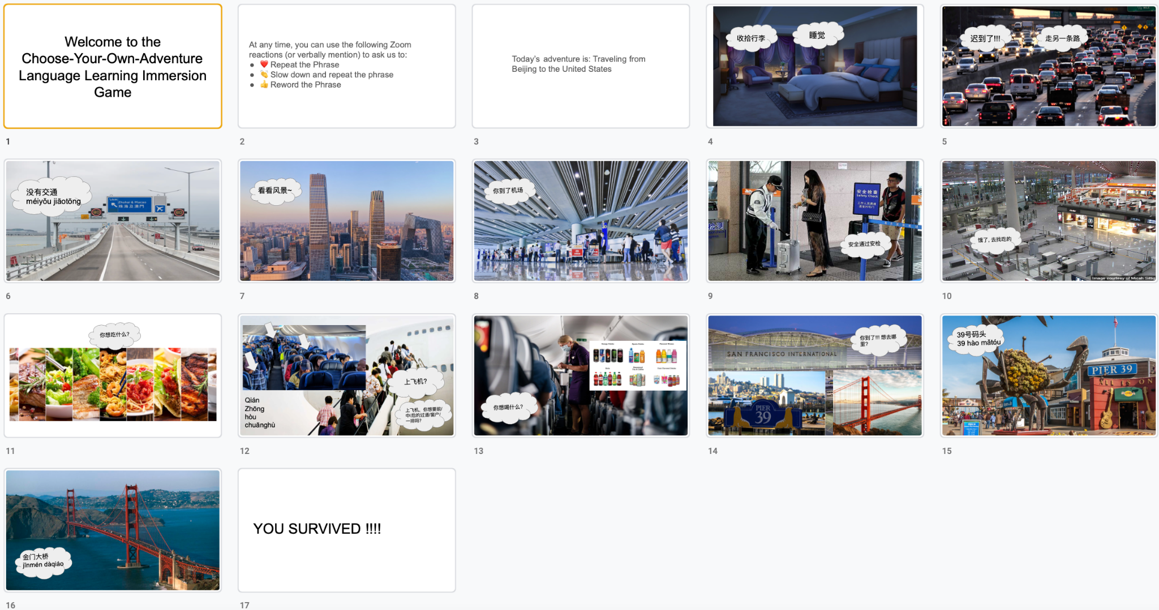
Chinese & Spanish/English Immersion

Slide 23


Marlon
Chinese / English Immersion
We assumed when users are immersed in real-life tasks in another language, this would prompt them to foster survival instincts in language learning.
Assumption
Results
Having different ways for users to interact with the scene and learn at their own pace motivates users to learn.
Learnings
Learners comprehend better with visuals and guiding prompts to help them find answers when learning a new dialect.
Validity
Our assumption remained correct but this experience also helped us learn how to capture differences in various dialects of a language.

Slide 24
Sam
Spanish / English Immersion
We assumed someone who has learned a language would few comfortable engaging and practicing in an immersive learning experience.
Assumption
Results
Although Sam has background in the language, she doesn’t have the Spanish accent and feels embarrassed of her own accent.
Learnings
Although users might learn a language, they might still feel certain aspects of learning a language (speaking, reading, writing, etc) are still difficult to master.
Validity
It was a nice experience for Sam but she would cringe if she had to hear a playback so she wasn’t completely comfortable (but it would help).
Notes:
Even though she didn’t like for people to hear her speak (would cringe), she knew this is how she would get better.
The story was a little bit too easy.
She understood the messages and meaning but struggled with remembering common vocabulary words (almond).

Slide 25
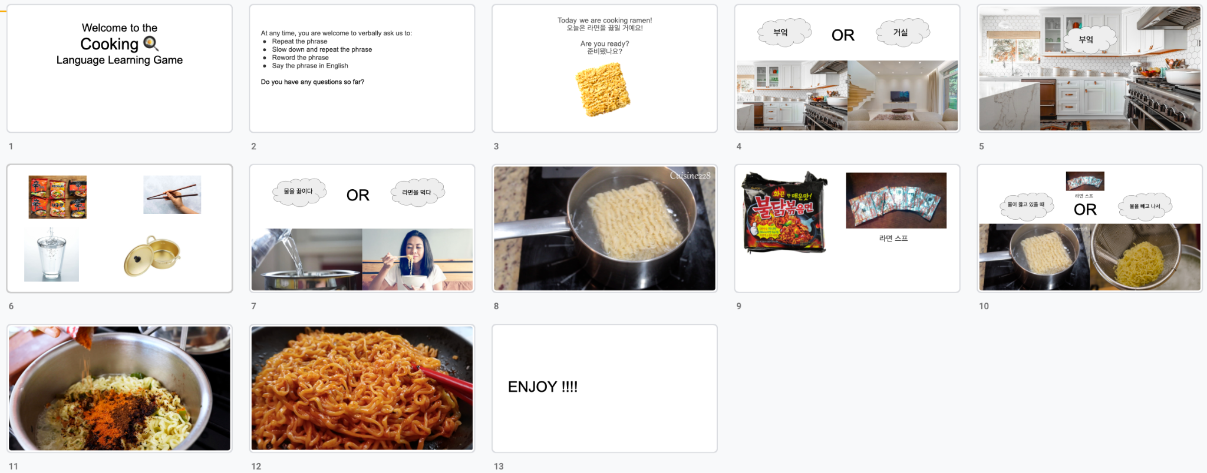
Korean / English Cooking

Slide 26
Lauren
Korean / English Cooking
Assumption
We assumed full immersion in a cultural activity (cooking food from the language’s culture) would encourage users to learn and use new vocabulary.
Results
Language learners are more confident using the language when in low-risk situations.
Learnings
Learners comprehend more with subtitles in the practice language. Full immersion can be difficult for beginners.
Validity
Our assumption proved to be correct – the user was engaged and willing to navigate unfamiliar situations.

Slide 27
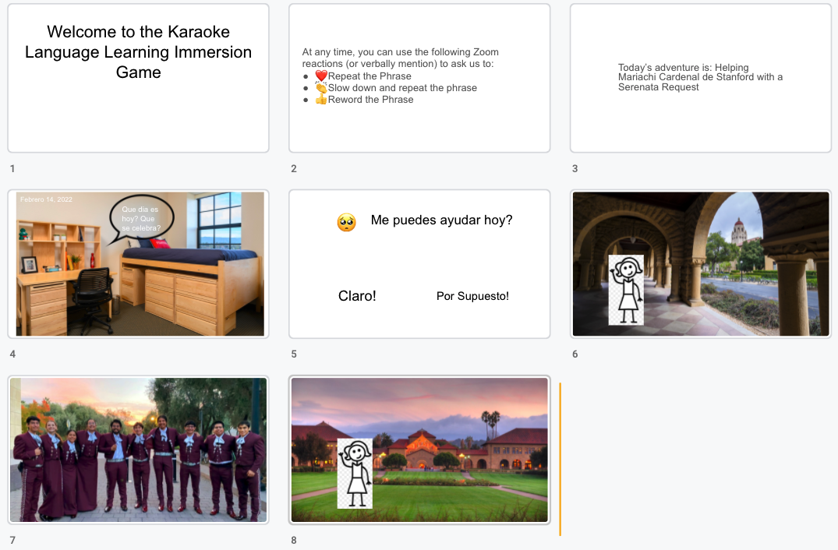
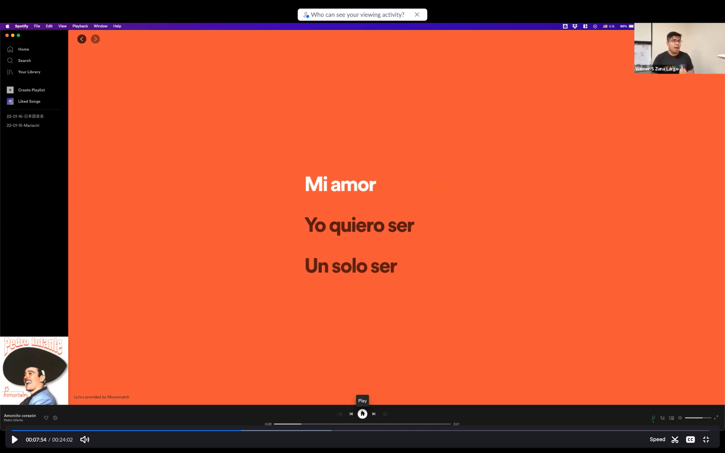
Spanish / English Karaoke Immersion

Slide 28
Brenda
Spanish / English Immersion
Assumption
We assumed that singing would help Brenda feel more connected to the language and culture of the language of interest, enhancing the Brenda’s interest and investment in language learning..
Results
Experience provided structure to Brenda, especially if not familiar. But experience is best when skills learned will be useful for Participant in future scenarios.
Learnings
Song choice matters, especially if representing a language. Best songs are those that deal more with everyday things, not just romance.
Validity
People like a karaoke learning experience. But, a new assumption showed us that Learners need more than pop culture songs.

Slide 29
Solution

Slide 30
Solution
Language Learners will benefit most from immersive experiences that prepare them for everyday life scenarios. Additionally, the difficulty of the experiences should be challenging enough to convey new knowledge yet easy enough to encourage learner to engage further.
What about academic applications?
New assumptions

Slide 31
Summary

Slide 32
Summary
Adria
John
Chris
May
Marlon
Sam
Lauren
Brenda
Notes:
Key Learnings
Difficulty, convenience, and dialects really affect language learning
Immersion is the best form of learning
Next Steps

Slide 33
THANKS!
Any questions?

